Slide 1
Cloudify your Windows File Server
Jan Egil Ring
Notes:
This is the slide shown before the presentation starts. When you are ready to go, tell the video operator to start the recording, and click to the next slide.

Slide 2
5
Video operator, did you start the recording?
Notes:
[REQUIRED SLIDE]
These slides are mandatory and help us with video post-processing. Please keep them as they are.

Slide 3
4
Notes:
[REQUIRED SLIDE]

Slide 4
3
Notes:
[REQUIRED SLIDE]

Slide 5
2
Notes:
[REQUIRED SLIDE]

Slide 6
1
Notes:
[REQUIRED SLIDE]

Slide 7
Automate hybrid and cloud environments using Azure Automation
Jan Egil Ring
Notes:
This is the slide shown before the presentation starts. When you are ready to go, tell the video operator to start the recording, and click to the next slide.

Slide 8
This Session
Understand how to configure hybrid file servers based on Azure File Sync
Learn how to leverage PowerShell DSC and Azure Automation State Configuration to fully automate Azure File Sync installation and configuation
Notes:
Please invest some time to reconsider your session: what is it that audience can get out of it? Try and be as precise as you can. If you are showing solutions, then focus on “how to”. If you present about a general technology, you’ll want to stick to “Be able to” or “Understand why/how”.

Slide 9
Agenda
Introduction – what is the goal?
Deployment
Monitoring
Backup
Demos
Install and configure Azure File Sync
Fully automated installation on Server Core

Slide 10


Why move your on premises file servers to the cloud?
Reduce on premises storage footprint
Centralize data
Reduce management overhead
Save $$$
Notes:
What is the goal?
Even though it might seem so, the message to customers isn’t that the replacement for on-premises file servers is OneDrive and SharePoint Online.
Sharepoint is very useful for Office document team share collaboration scenarios.
While the trend is to move user and shared data from traditional file servers to cloud services like Sharepoint Online, in most cases the file server won`t go away. It is used for many other purposes, such as centralized application data.
-Reduce footprint on an expensive SAN
-Reduce management overhead
-Expand capacity as data grows – including backup capacity

Slide 11











Advantages of Azure File Sync
Cloud Tiering
Cloud Access
Azure Backup
Multi-site Sync
File Share
Cloud Backup
Rapid File Server DR
SMB
NFS
Users
Work Folders
File Sync Server 3 Stockholm
Applications
File Sync Server 1 Oslo
File Sync Server 2 Copenhagen

Slide 12
Deploy Azure File Sync in a few easy steps
4
3
2
1
Sync Group
Azure File Share
Cloud Endpoint
Server Endpoint 1
OSL
X:\mktg
CPH
X:\mktg
Server Endpoint 2
Sync Agent
Sync Agent

Slide 13
Step 1 - Create Azure Storage Account and file share
Azure File Share

Slide 14
Step 2 – Create Sync Group and connect it to Azure File Share
Sync Group
Azure File Share
Cloud Endpoint

Slide 15
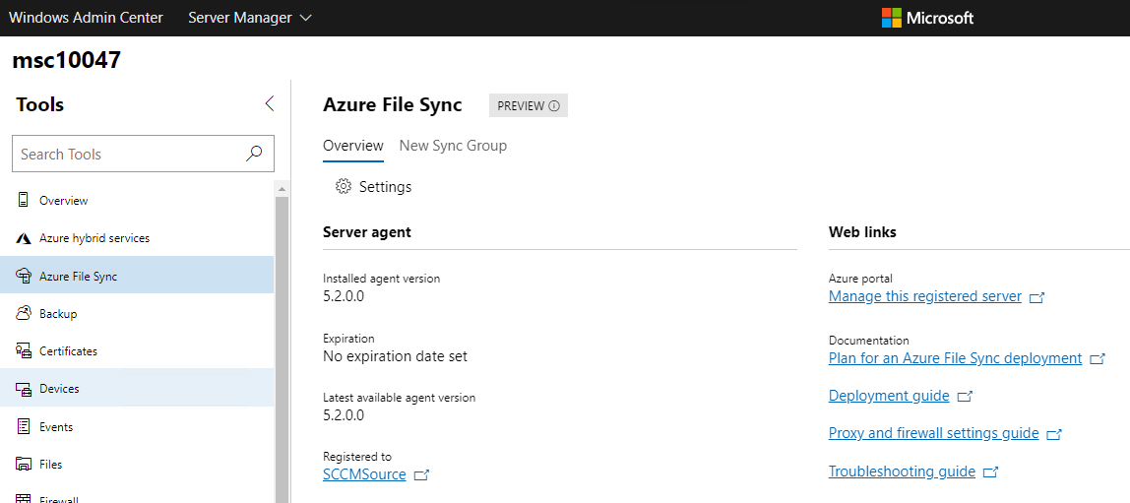
Windows Admin Center integration
Windows Admin Center 1904
Added support for Azure File Sync and several other Azure hybrid services
Notes:
Consolidating all of Windows Admin Center’s optional Azure services into a centralized hub, the Azure hybrid services tool lets you easily discover and leverage the value that Azure can bring to your on-premises or hybrid environment.
https://techcommunity.microsoft.com/t5/Windows-Admin-Center-Blog/Windows-Admin-Center-1904-GA-update-is-now-available/ba-p/443407

Slide 16

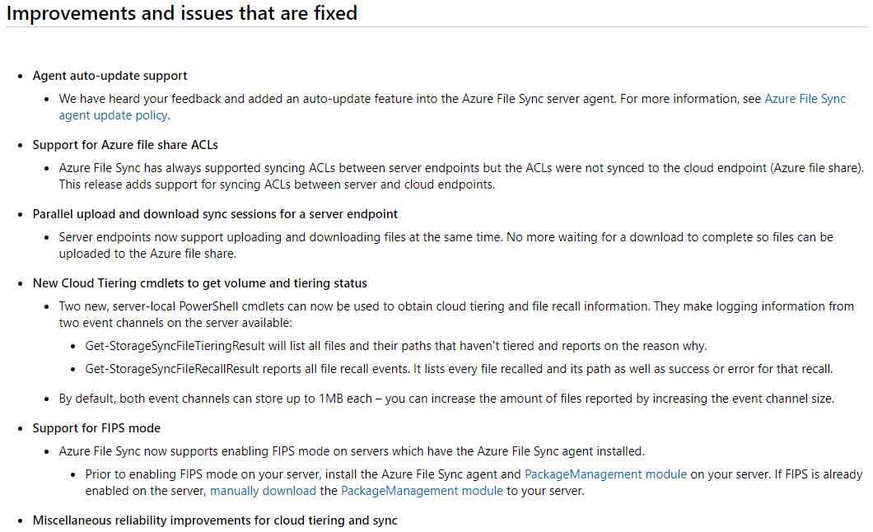
Azure File Sync Agent Version 6
Released April 22, 2019 (KB4489736)
Support for Az PowerShell module
Install-Module –Name Az
Notes:
Support for Az PowerShell module
Install-Module –Name Az

Slide 17
Install and configure Azure File Sync

Slide 18
Monitoring
Portal
Azure Monitor
Event logs and performance counters on the servers
Coming: E-mail alerts and logging
https://docs.microsoft.com/en-us/azure/storage/files/storage-sync-files-monitoring (article published January 2019)
Notes:
In the Azure portal, you can view registered server health, server endpoint health (sync health), and metrics.
Use Azure Monitor to monitor sync, cloud tiering, and server connectivity. Metrics for Azure File Sync are enabled by default and are sent to Azure Monitor every 15 minutes.
Use the Azure File Sync performance counters on the server to monitor sync activity.

Slide 19
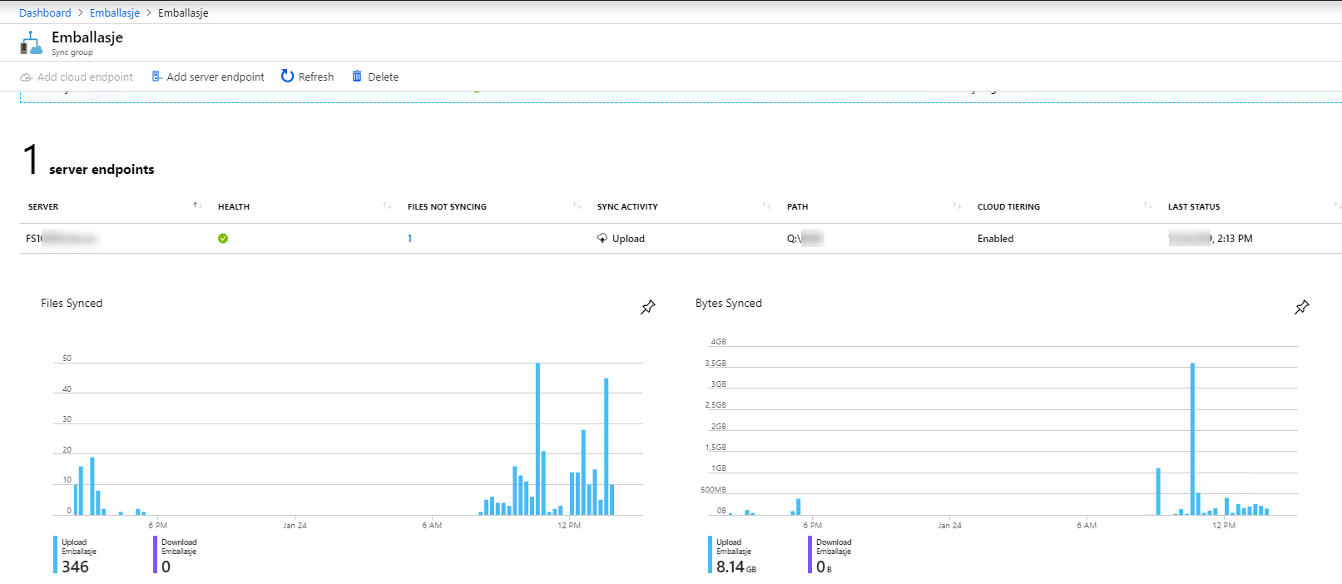
Azure File Sync - monitoring
Azure Portal
https://portal.azure.com
Notes:
Added in January 2019

Slide 20
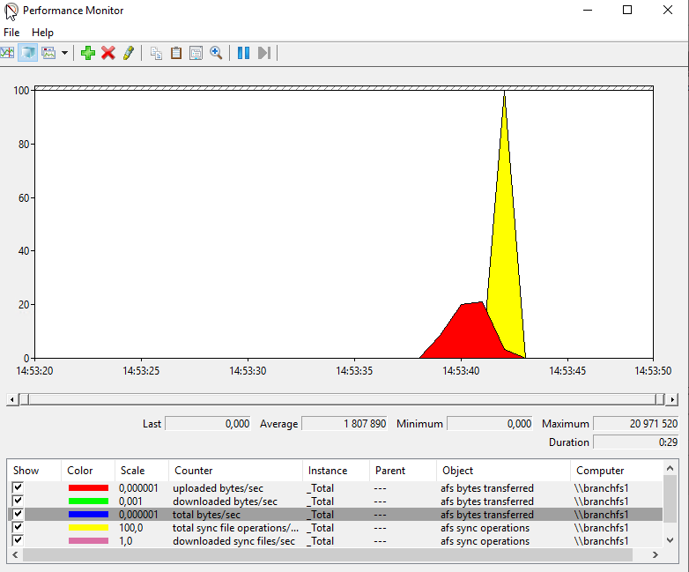
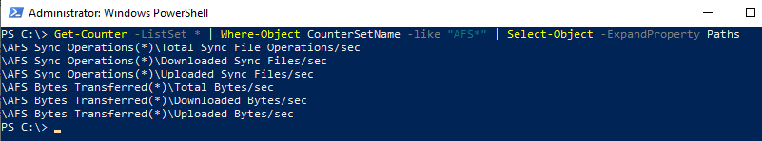
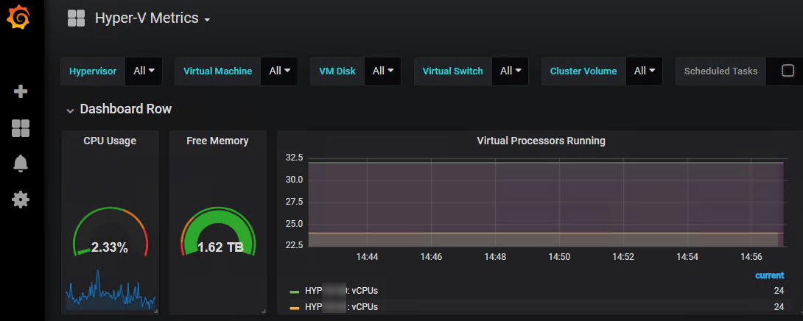
Azure File Sync - monitoring
Performance Counters
Notes:
Grafana and InfluxDB

Slide 21
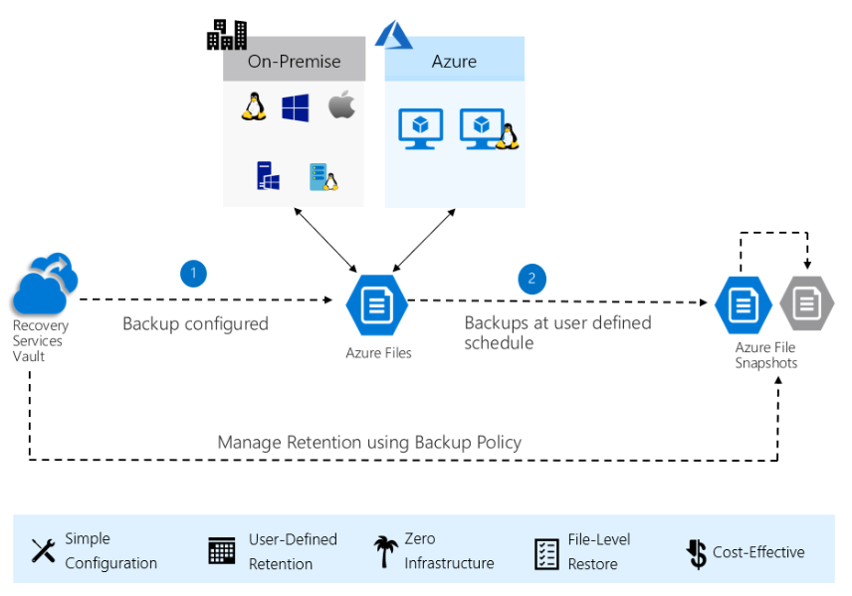
Backup
Azure Backup
Azure Backup agent (MARS)
System Center DPM
Azure Backup Server
Azure IaaS VM Backup
Azure File Shares (preview)
https://docs.microsoft.com/en-us/azure/backup/backup-introduction-to-azure-backup
https://docs.microsoft.com/en-us/azure/backup/backup-azure-files
https://azure.microsoft.com/en-us/blog/introducing-backup-for-azure-file-shares/
Notes:
A Recovery Services vault is an online storage entity in Azure used to hold data such as backup copies, recovery points, and backup policies.
You can back up at scale by selecting multiple file shares in a storage account and apply a common policy over them.
Since Azure Backup utilizes file share snapshots, you can restore just the files you need instantly even from large file shares.
Azure Backup lets you browse the restore points of your file shares directly in the Azure portal so that you can pick and restore only the necessary files and folders.
Tentative timeline is H1 CY19

Slide 22
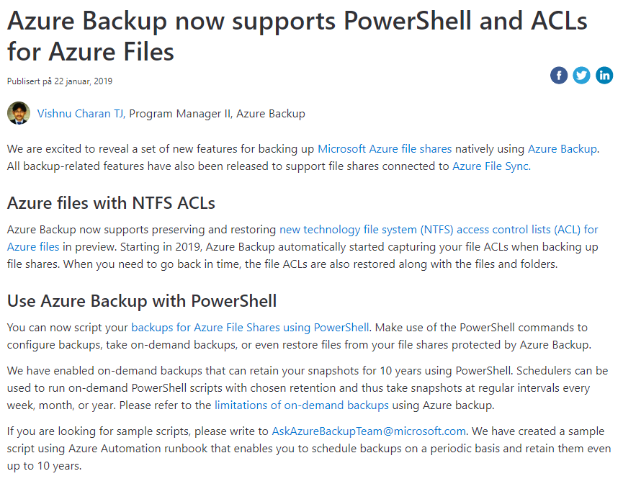
https://azure.microsoft.com/nb-no/blog/azure-backup-now-supports-powershell-and-acls-for-azure-files/

Slide 23
More details about Azure File Sync features
Cloud Tiering
Multi-site sync
Rapid file server DR
Direct cloud access
Integrated cloud backup
2018 Ignite sessions
THR2253 - Azure Files and Azure File Sync technical foundation
THR2254 - Deploying Azure File Sync

Slide 24
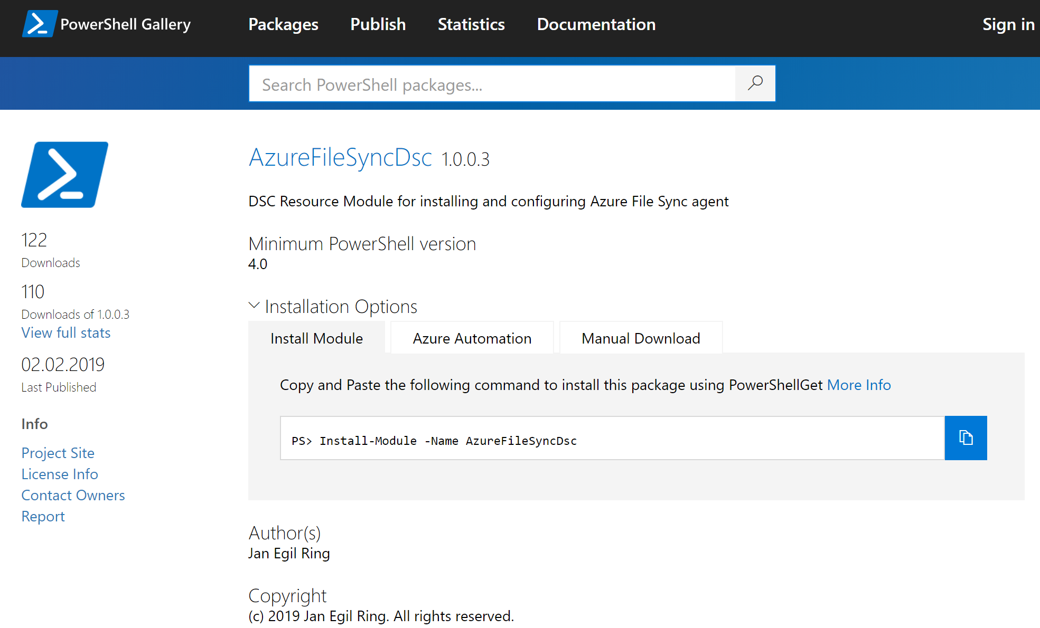
Azure File Sync – automated provisioning
https://github.com/janegilring/AzureFileSyncDsc
Notes:
Works on 2012 R2 and later – including 2019

Slide 25
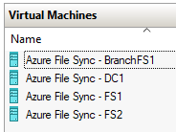
Azure File Sync – lab environment
Lability – test lab deployment and configuration PowerShell module
Easily deploy (and re-deploy) full lab environments on Hyper-V in Windows 10 fully automated
Leverages PowerShell Desired State Configuration under-the-hood
Detailed introduction:
http://www.powershell.no/hyper-v,/powershell/dsc/2017/07/19/lability.html
Configuration script for Azure File Sync lab used in this presentation is available in GitHub:
https://github.com/janegilring/Presentations/2019 - PSConfEU
Links will be posted on Twitter after the session – follow @JanEgilRing
Notes:
Grab a coffee and your lab will be deployed when you get back
If you don`t have access to a Windows 10 machine with sufficient resources, one option is to provision a Windows 10 VM in Azure. It can be configured to use Auto-shutdown in order to minimize costs.

Slide 26
Demo
Automated provisioning

Slide 27
Summary
Azure Automation
Update Management
Configuration Management
Process Automation
Use new services (Functions, Event Grid, etc) for domain specific scenarios, and Azure Automation for other automation scenarios

Slide 28
Key takeaways
Take advantage of cloud storage by not compromising on prem experience.
1
Reclaim your on premises storage space for other purpose
2
3
Easy to get started
Provision Sync Service and storage account in Azure
Install and configure agent
Use configuration management to automate setup and configuration

Slide 29
Notes:
[REQUIRED SLIDE]
Make sure you provide all materials that audience needs to reproduce your demos.
Either upload them as a PowerShell module to www.powershellgallery.com (preferred for reusable functions)
Or, upload them to our github repository (ask the girls at the info desk to provide you with access)
Or, upload them to your own github repository
Please make sure all materials are available by the time your presentation starts, or at minimum upload them right after your presentation

Slide 30
Resources
Azure File Sync documentation
https://docs.microsoft.com/en-us/azure/storage/files/storage-files-planning
https://docs.microsoft.com/en-us/azure/storage/files/storage-sync-files-planning
https://docs.microsoft.com/en-us/azure/storage/files/storage-sync-files-deployment-guide
Slides and demos from this presentation
https://github.com/janegilring/Presentations
Lability – build an automated Azure File Sync lab environment
http://www.powershell.no/hyper-v,/powershell/dsc/2017/07/19/lability.html
https://github.com/janegilring/PSCommunity/tree/master/Lability

Slide 31
Notes:
[REQUIRED SLIDE]
If you sticked to your timing, you now have 15 min left for Q&A. If you missed your timing, you will have to leave the room when your slot is over. In this case, invite your audience to the coffee break and offer to cover questions there.
IN ANY CASE please point your audience to the conference app and the session voting. By the time the conference opens, the eventraft app *should* have the option to vote on sessions.
Please MAKE SURE you leave your room when your slot is over. The next speaker would like to set him/herself up and get everything up and running.

Slide 32
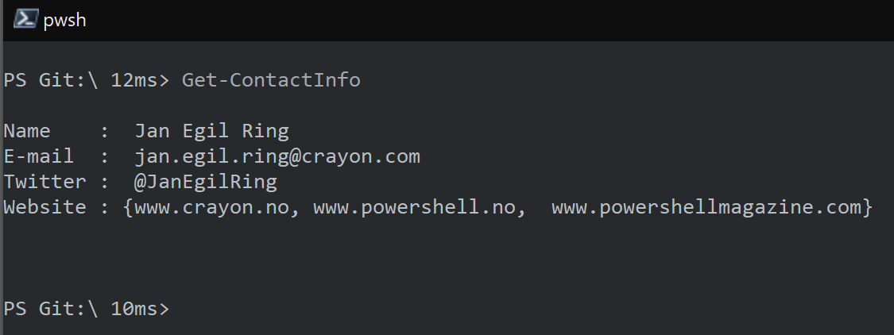
about_Speaker

